Slide 1

UFF-FGCU
Report to Faculty Senate
March 29, 2024

Slide 2
Topics
  Membership Density
  Recertification Process
  Membership Form (SB 1746)
  Bargaining
  Merit Pay
  Compression & Inversion
  Call for Service
  Upcoming Chapter Meeting & Social
  Questions

Slide 3
UFF-FGCU Membership Density – 61%
As of March 28, 2024:
  Current dues-paying UFF-FGCU members: 334
  Total in-unit faculty: 546
  Membership density: 61%
We are in the process of updating the UFF-FGCU email group in Outlook to add new members and remove resigned members.

Slide 4
Recertification Process Update
  March 7: Recertification packet delivered to Florida Public Employee Relations Commission (PERC).
  March 21: UFF state office collected one set of our chapter’s Showing of Interest (SOI) cards. We have the other set.
  Waiting for confirmation from PERC that our recertification has been approved. We do not anticipate any issues.
  IF we are denied - which is highly unlikely – the state UFF office will submit one set of the signed cards to PERC, and PERC will then facilitate a vote of all in-unit faculty on whether or not they want to retain the FGCU chapter of UFF. To be successful, we would need 51% of votes returned to be YES votes.

Slide 5
Membership “Form” SB 1746
  From State UFF Legislative Update: As you may recall, a PERC membership form was mentioned in SB 256 (2023) but this “form” was not considered mandatory by PERC. So, the legislature and Governor took care of this ambiguity in this current legislation. As provided in this bill (SB 1746), the newly required “form” only applies to chapters who will reach a membership level of 60% or more.
  FEA is working on an electronic “form” for all UFF-FGCU members to ”sign” before our next recertification date of March 9, 2025. Stay tuned for additional information, likely not until fall.
  FEA has current lawsuit pending on the mandatory signing of this form as a violation of First Amendment rights.

Slide 6
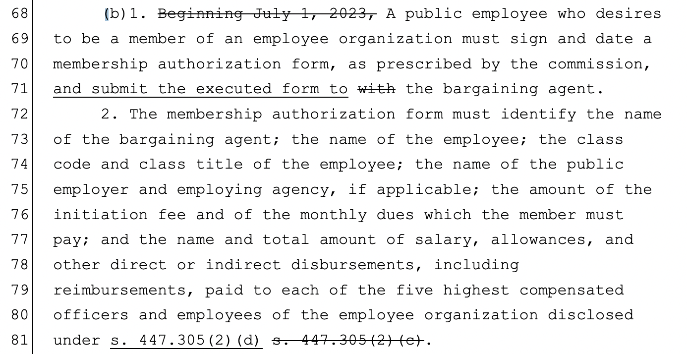
Membership “Form” SB 1746

Slide 7
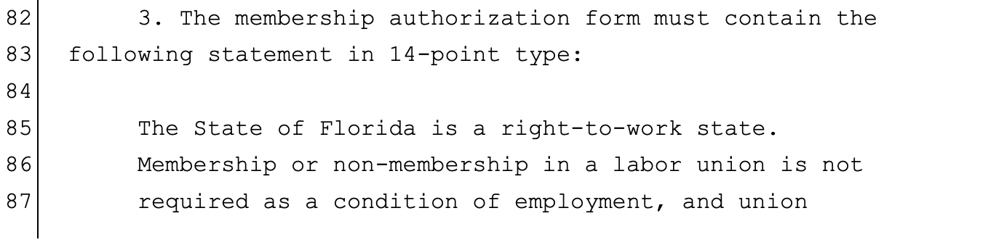
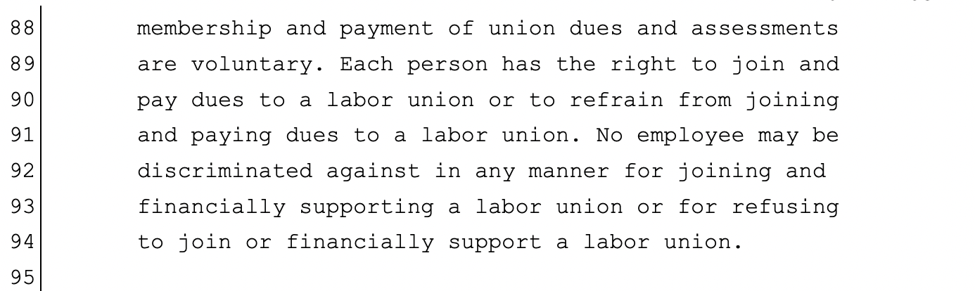
Membership “Form” SB 1746

Slide 8
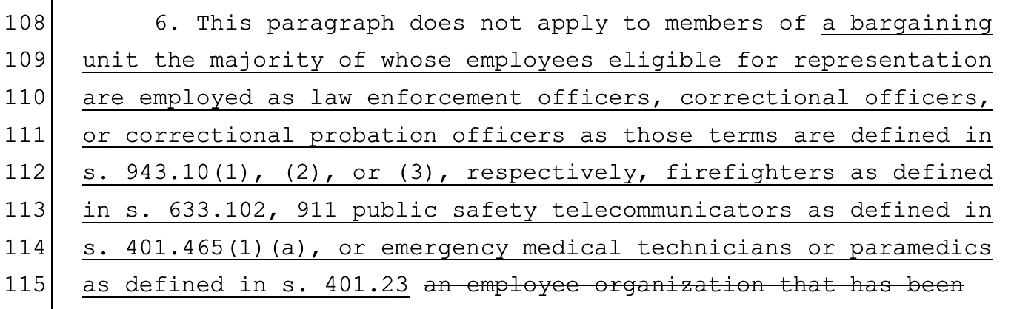
Membership “Form” SB 1746

Slide 9
Bargaining
We made some collaborative progress at the last session and came to tentative agreement on revised Articles 10 (promotions) and 14 (evaluations).
You should have received PDFs showing track changes in an email from the bargaining team update on Monday.
We know that what faculty want now is discussion about salaries. We’ve made a first offer (for an 11% across-the-board increase), but the BOT has said it’s not ready to talk about salaries.
We are making it a priority to begin these most important negotiations at the next bargaining session on April 12.

Slide 10
Future Bargaining Sessions
Upcoming bargaining sessions:
The next session will be in person on Friday, April 12, from 9:00 to 1:00. Location will be announced when determined.
The following two sessions will be virtual from 9:00 to 11:00 on the following Mondays:
April 15
April 22
Access virtual sessions here: https://www.fgcu.edu/facultystaff/collective-bargaining/united-faculty-of-florida/#MeetingNoticesDatesMinutes
We encourage EVERYONE who is available to attend.

Slide 11
Merit Pay Committee
Adjustment to 2023-2024 Merit Pay Plan to accurately reflect FPED timeline:
Nine Month Faculty
April 30: Evaluator/supervisor returns proposed draft written annual evaluation to faculty member.
June 5: The finalized annual evaluation is signed by both the evaluator/supervisor and faculty member.
Twelve Month Faculty
• June 30: Evaluation completed.

Slide 12
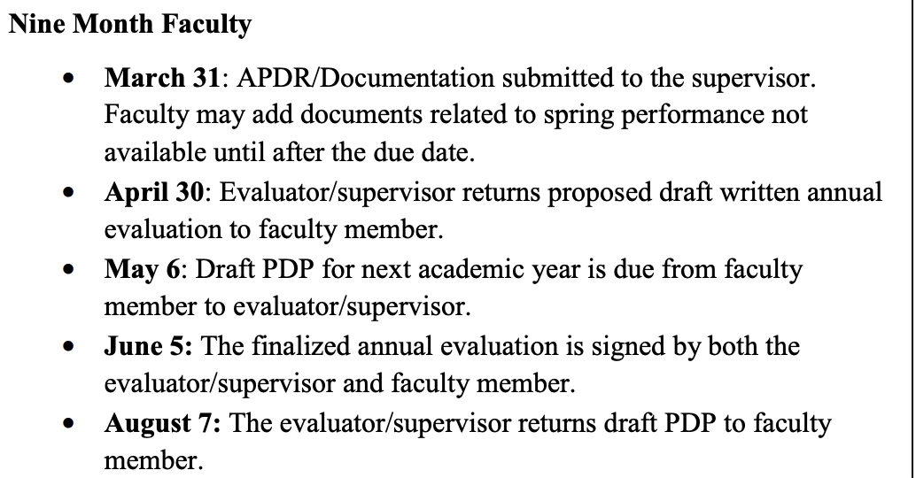
FPED Annual Evaluation Timeline
FPED Page 15

Slide 13
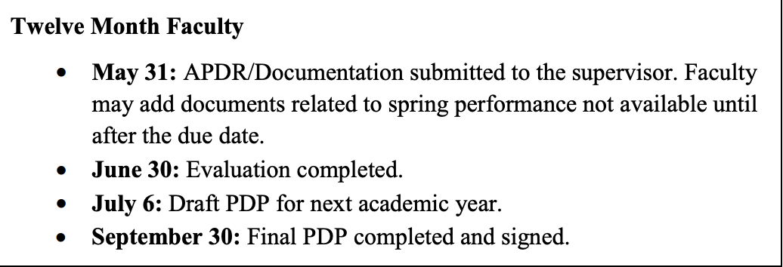
FPED Annual Evaluation Timeline
FPED Page 16

Slide 14
Compression & Inversion Committee
Update from Kara Winton, C&I Committee Co-Chair:
As mentioned previously, we’ve worked hard and established a methodology to group employees for comparison and calculate compression.
We are working on a methodology to analyze inversion.
After that, we will need to decide how to allocate the $300,000 negotiated.
The team will make a full report outlining process when it is complete.

Slide 15
Call for Service
UFF-FGCU will soon be putting out a call for service for the 2024-2025 Academic Year (serves from August 1, 2024 to July 31, 2025).
We absolutely MUST have more involvement in UFF-FGCU service or your union officers are going to burn out!
Please consider serving in one of the following roles:
  Vice President
  Bargaining Team
  Diversity Team
  Grievance Team
  Steward Team

Slide 16
Chapter Meeting & Social
The UFF-FGCU Executive Committee is plans to schedule a spring chapter meeting and/or final social.
Typically hold one chapter meeting and one social each fall and spring semester.
Previous chapter meeting held in early Fall 2023. Previous social was February 16.
Members and non-members interested in joining are welcome to attend.
IF we can get something planned, turn around time will be short. Please keep an eye out for announcement.

Slide 17
Questions?
  Please reach out to
  Carolynne Gischel, UFF-FGCU President
  with any questions:
  cgischel@fgcu.edu or cgischel@gmail.com
  Stronger together!

